Slide 1








E-Elementary
Problem Statement
Solution Provided
Project Description
UML
Online elementary school management system.
Technology Used
Demo
Challenges
Perspective

Slide 2
It’s safe to say that Covid-19 has changed education forever.
Schools are recognizing now more than ever the importance of their presence online. And for elementary schools the challenge is not only to maintain the standard quality of education but to keep students engaged and motivated. So the need of kids centered online schools is only arising.

Slide 3
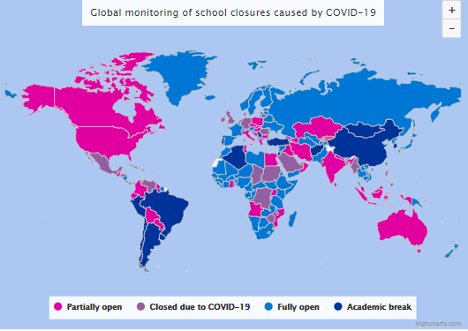
On the 2/1/2021:
221,964,329 affected learners
12.7% of total enrolled learners
28 country-wide closures

Slide 4

E-Learning
Classroom is free for most teachers and allows teachers to communicate with their entire class from a distance. In the time since the COVID-19 outbreak began, Google has seen users double to over 100 million users.

Slide 5
Teacher
Grades
View Grades’ details
Subjects
View Subjects
Homework
View Homework
Update Homework
Admin
Classes
Add Class
Update Class
Remove Class
Students
Add Student
Update Student
Remove Student
Teachers
Add Teacher
Update Teacher
Remove Teacher
Accounts
Add Account
Update Account
Remove Account
E-Elementary is an online elementary school management system that provides a safe schooling experience for elementary schools.
Student
Grades
View Grades’ details
Subjects
View Subjects
Homework
View Homework

Slide 6
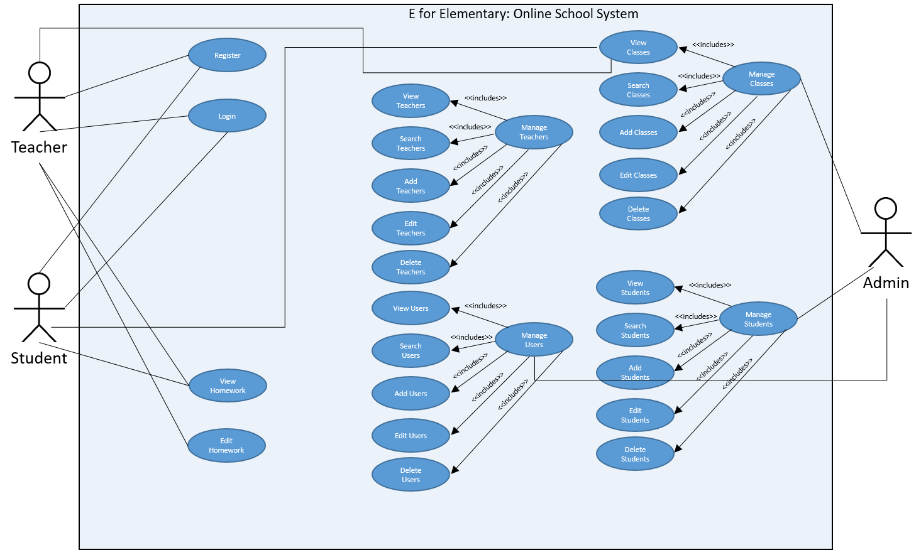
Use Case Diagram

Slide 7
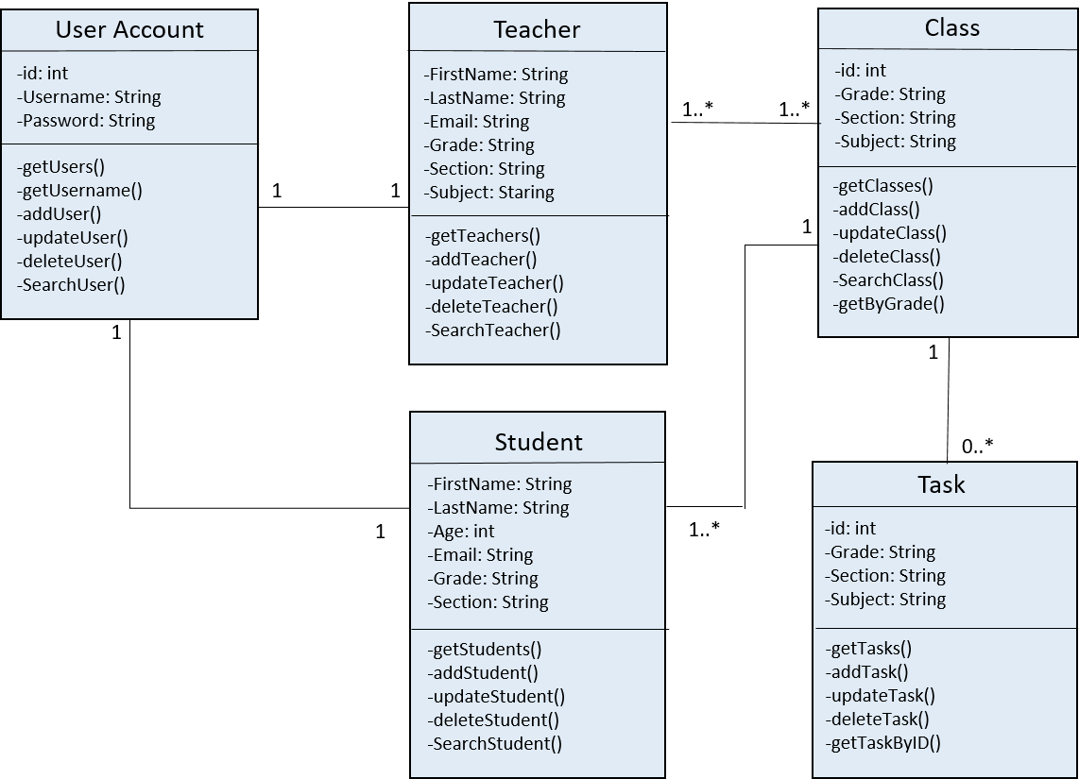
Class Diagram
1..*
Homework

Slide 8




MongoDb
Database
System
Express
Backend Web Framework
Angular
Frontend Framework
Node.js
Backend Runtime Environment
M
E
A
N

Slide 10
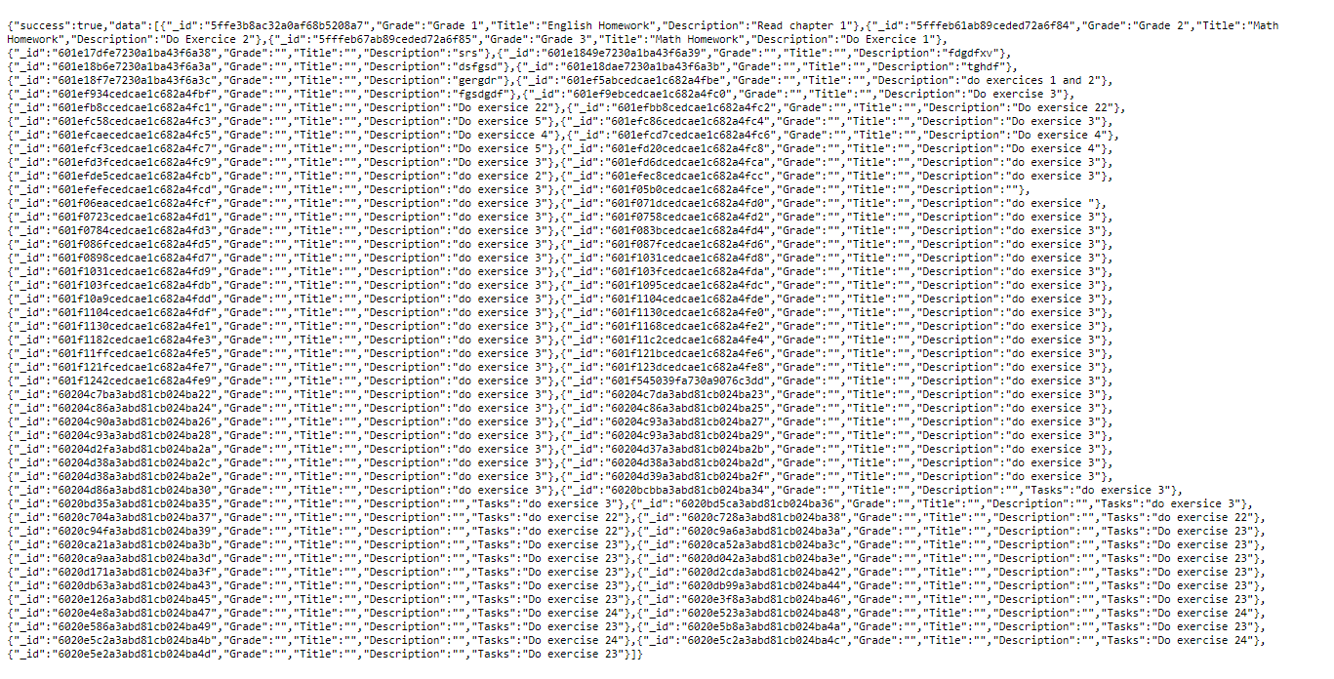
The Tasks Web Service

Slide 11
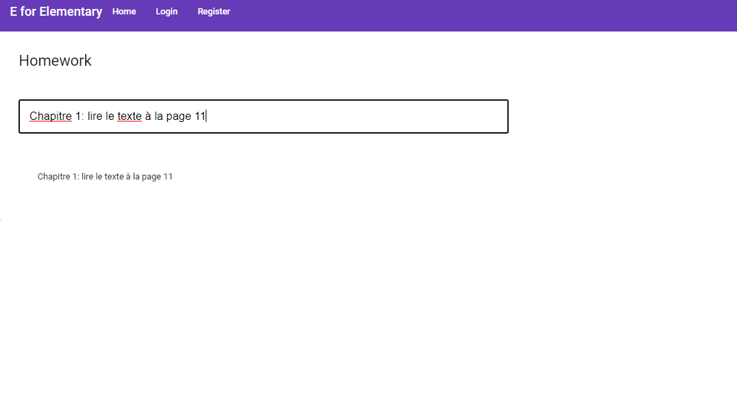
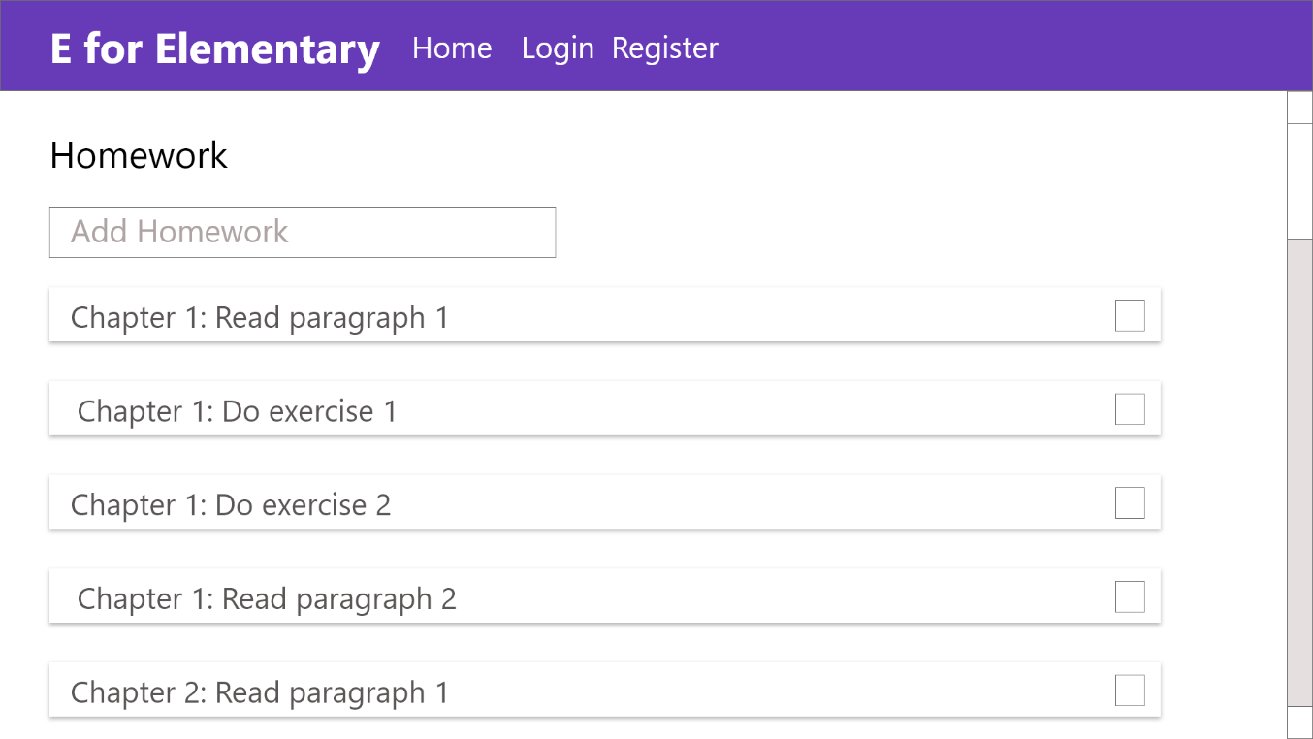
The Homework Page
Teachers should be able to add Homework.

Slide 12
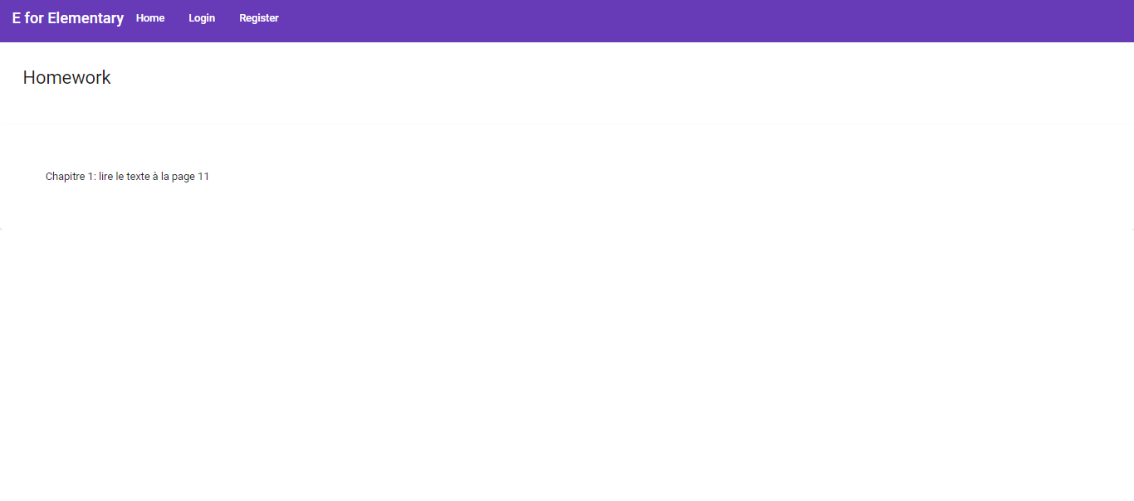
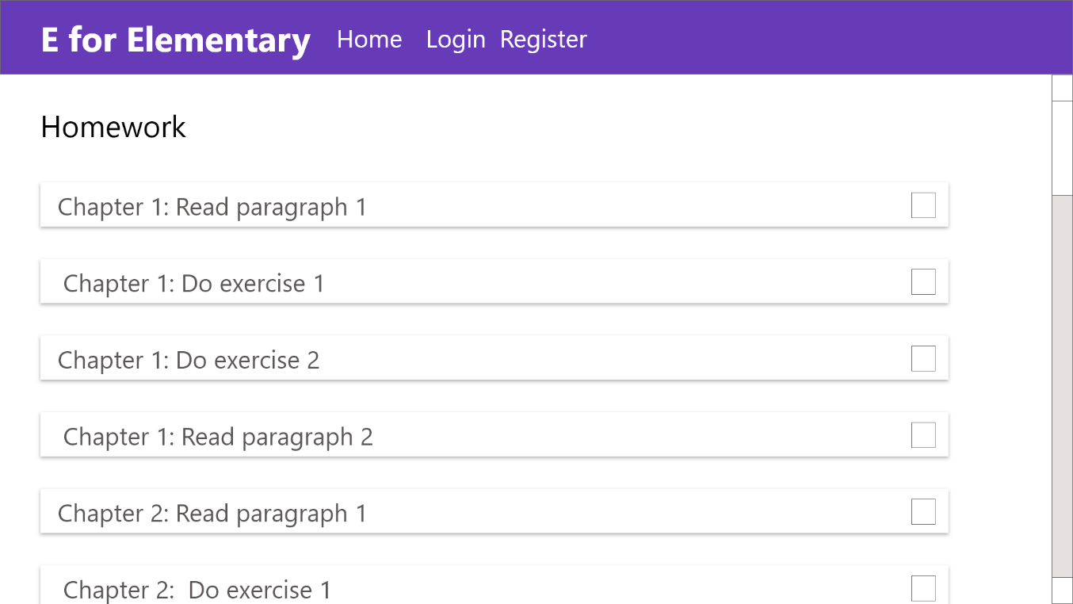
The Homework Page
Students should be able to check finished homework.

Slide 13
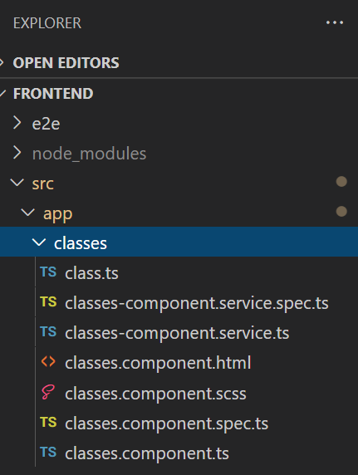
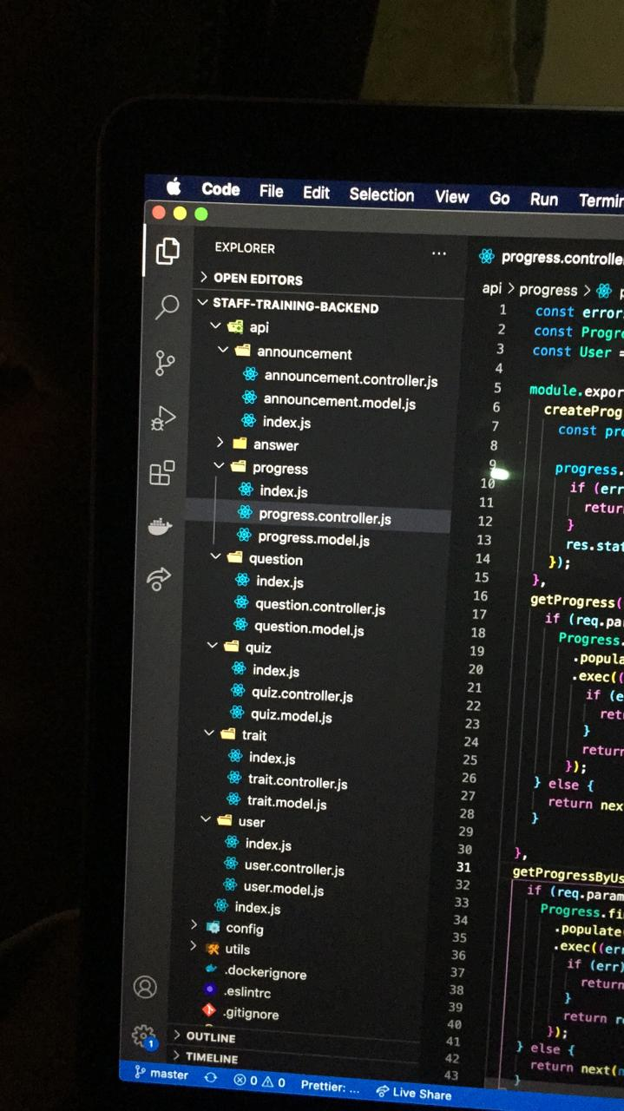
Application Architecture
My project.
Moustafa’s project.

Slide 14
Creating this project has helped me develop my technical skills and challenged me to learn web app development, a field that is new to me, and implement what I’ve learned quickly. Although it was not a complicated one, it sure did take a lot of dedication to make!

Slide 15
Thank you

